Slide 1
Front End Engineering-I Project
Team Details:
2310990350- Aditi Bansal
2310990351-Aditya Grover
2310990352-Aditya Pathania(Team Leader)
Faculty Coordinator: Dr. Chetna Kaushal
:
Chitkara University Institute of Engineering and Technology,
Chitkara University, Punjab

Slide 2
Table of Contents
Introduction
Problem Statement
Technical Details
Key Features
Project Highlights
Conclusion
References/Links used

Slide 3
Introduction
Countdown to a Special Event
The tittle of Project is Countdown to a Special Event .
The Project group 4 comprises of :
2310990350-Aditi Bansal.
2310990351-Aditya Grover
2310990352-Aditya Pathania (Group Leader)
The purpose is to track and display the remaining time before the special event and the goal is to help user to manage their time effectively by creating a visual reminder of when the event will occur. This project also contain the functionality to customize your own countdown web page.

Slide 4
Problem Statement
In today's fast-paced world, it's easy for us to get caught up in our hectic schedules and lose sight of the passing moments. We often find ourselves so engrossed in our daily routines that we forget to embrace and celebrate those wonderful, fleeting moments. For instance, the annual New Year countdown serves as a poignant reminder that we are swiftly approaching the dawn of a fresh year. It underscores the notion that time is slipping through our fingers with astonishing speed, urging us to cherish and make the most of every precious second.
In the past times numerous ways like hour glasses and ancient sundials were used as countdown times for counting small gaps of time but now they are replaced by digital countdown timers to take account of time in much efficient way.

Slide 5
Technical Details
HTML: HTML provides a structured way to organize content on the web. The basic structure of webpages is made using tags :
<!DOCTYPE html>`: This declaration defines the document type and version of HTML being used (HTML5 in this case).
<html lang="en">`: The root element of the HTML document, specifying the language (English) for screen readers and search engines.
<head>`: Contains meta-information about the HTML document, such as character set, viewport settings, and the title of the page.
<meta charset="UTF-8">`: Specifies the character encoding for the document, ensuring proper rendering of text.
<meta name="viewport" content="width=device-width, initial-scale=1.0">`: Sets the viewport properties for responsive design on various devices.
<title>Main Web Page</title>`: Sets the title of the HTML document, which appears on the browser tab.

Slide 6
Technical Details
<style>`: Contains internal CSS for styling the HTML document.
<body>`: Represents the content of the HTML document, including text, images, links, and other elements.
<div class="container">`: Defines a container with a specified class for styling; used to group and style content.
<h1>`: Defines a top-level heading with the text "Countdown For Special Events."
<div class="event">`: Represents a container for an event with a specified class for styling.
<h2>`: Defines a subheading for each event.
<a href="Fee Project 7.html" target="_blank">`: Creates a hyperlink with a target attribute to open the linked page in a new browser window or tab.
<br>`: Inserts a line break within the text content.

Slide 7
Technical Details
CSS: CSS (Cascading Style Sheets) is a crucial component of web development that is used for styling and visually enhancing web pages. CSS provides a consistent way to apply styles to multiple elements across a website using properties like:
Margin: Specifies the space outside the element's border.
Padding: Sets the space between the element's content and its border.
Color: Defines the text color of an element.
Background color: Determines the background color of an element.
Text decoration: Adds visual effects to text, like underlining or overlining.
Font size: Specifies the size of the text.
Font family: Defines the typeface or font family of the text.
Border: Sets the border properties for an element.
Border radius: Rounds the corners of an element's border.
Box shadow: Adds a shadow effect to an element.
Text-align: Aligns the text within an element (e.g., left, right, center).

Slide 8
Technical Details
JavaScript: JavaScript is used to introduce logic in a webpage. Here are some functions used in our project:
document.addEventListener("DOMContentLoaded", function () { ... }) : Listens for the DOMContentLoaded event and executes the enclosed function when the DOM is fully loaded.
var countDownDate = new Date ("Jan 1, 2024 00:00:00").getTime() : Initializes a variable with the target date and time for the countdown.
var x = setInterval(function () { ... }, 1000) : Sets up an interval (every 1000 milliseconds or 1 second) to update the countdown timer.
var now = new Date().getTime() : Retrieves the current date and time.
var distance = countDownDate - now: Calculates the time difference between the target date and the current date.
var days = Math.floor(distance / (1000 * 60 * 60 * 24)) : Calculates the remaining days.
var hours = Math.floor((distance % (1000 * 60 * 60 * 24)) / (1000 * 60 * 60)) : Calculates the remaining hours.

Slide 9
Technical Details
var minutes = Math.floor((distance % (1000 * 60 * 60)) / (1000 * 60)) : Calculates the remaining minutes.
var seconds = Math.floor((distance % (1000 * 60)) / 1000) Calculates the remaining seconds.
document.getElementById("days").innerHTML = `${days}: Updates the HTML element with the remaining days.
document.getElementById("hours").innerHTML = `${hours}: Updates the HTML element with the remaining hours.
document.getElementById("minutes").innerHTML = `${minutes} : Updates the HTML element with the remaining minutes.
document.getElementById("seconds").innerHTML = `${seconds} : Updates the HTML element with the remaining seconds.

Slide 10
Key Features
Some of Key Features of This project are:
• Interlinking of multiple web pages: The project consists of one main web page and other multiple designed countdown web pages.
• Multiple themes: This project has some pre-designed countdown pages for major social events.
• Use of foundational web development languages: The project will utilize HTML, CSS and JavaScript which are the foundational languages for web development.
• Incorporation of libraries and tools: The project will use tools and libraries such as a text editor (Visual Studio Code), web browser for testing.
• Attractive Design: Create an appealing and visually pleasing design for the popup card that aligns with the website's branding and style. Use CSS to enhance the visual presentation of the popup and make it visually appealing.
• Customizable: This project has custom feature where user can custom text and other sections as per his needs.

Slide 11
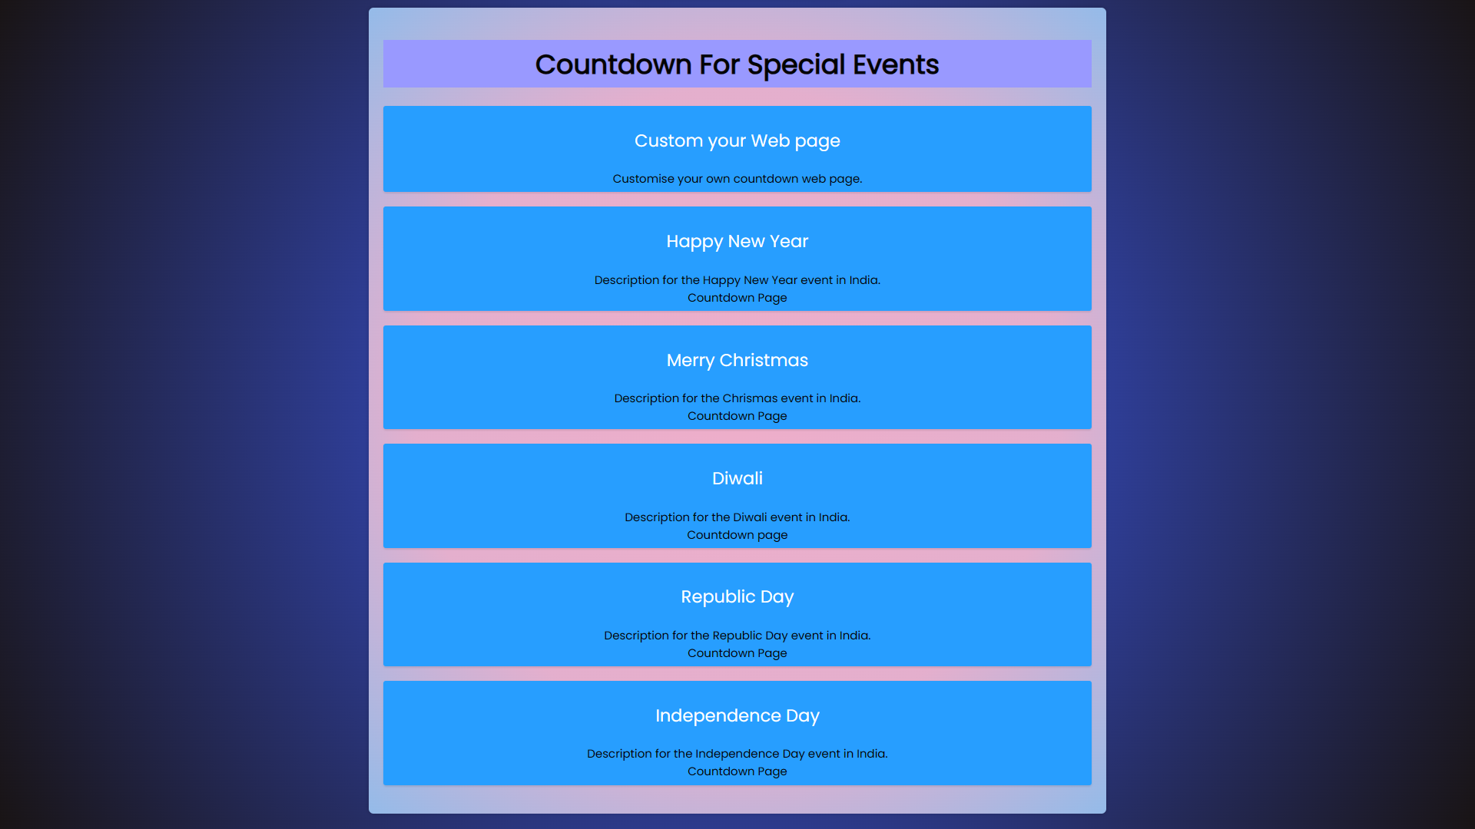
Project Highlights
Home Page

Slide 12
Project Highlights
Home Page Html Tags Used
The HTML Tags used to define the basic structure of Home page are :
<!DOCTYPE html>: This declaration defines the document type and version of HTML being used (HTML5 in this case).
<html lang="en">: The root element of the HTML document, specifying the language (English) for screen readers and search engines.
<head>: Contains meta-information about the HTML document, such as character set, viewport settings, and the title of the page.
<title>Main Web Page</title>: Sets the title of the HTML document, which appears on the browser tab.
<style>: Contains internal CSS for styling the HTML document.
<body>: Represents the content of the HTML document, including text, images, links, and other elements.
<div class="container">: Defines a container with a specified class for styling; used to group and style content.
<h1>: Defines a top-level heading with the text "Countdown For Special Events.".
<a href="Fee Project 7.html" target="_blank">: Creates a hyperlink with a target attribute to open the linked page in a new browser window or tab.

Slide 13
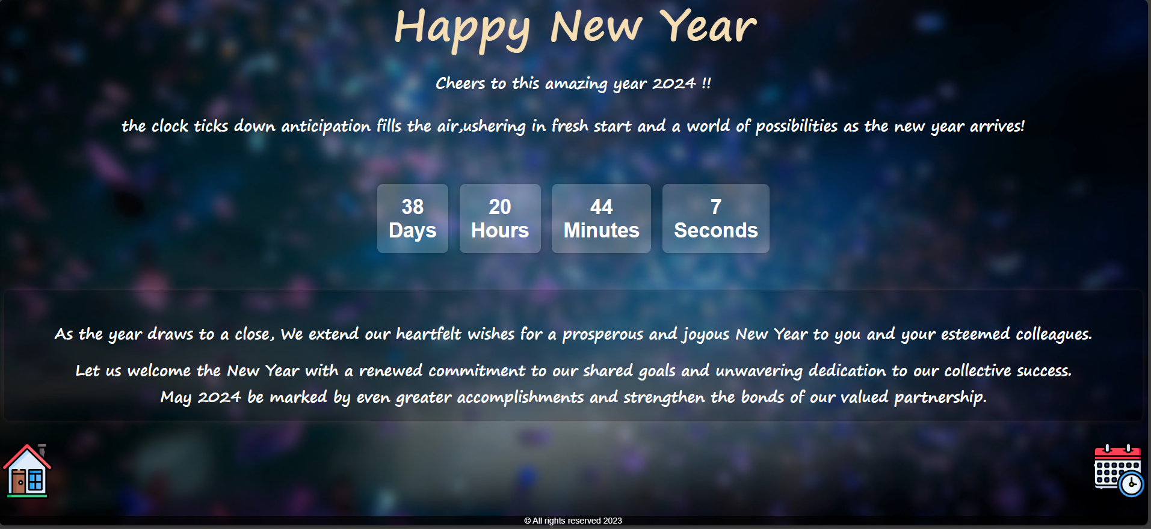
Project Highlights
New Year Countdown web Page

Slide 14
Project Highlights
New Year Html Tags Used
The main HTML tags used in structuring of New Year countdown web page are:
<html>: Defines the root of an HTML document.
<link>: Specifies external resources, such as stylesheets, linked to the document.
<body>: Represents the content of an HTML document, including text, images, links, etc.
<head>: Contains meta-information about the HTML document, such as title and links.
<header>: Represents introductory content at the beginning of a section or page.
<style>: Contains CSS (Cascading Style Sheets) to define the presentation of the document.
<title>: Defines the title of the HTML document, displayed in the browser's title bar or tab.
<div>: A container element used to group other HTML elements and apply styles or scripting.
<span>: An inline container used for applying styles or scripting to a specific portion of text.
<p>: Represents a paragraph of text.
<footer>: Represents the footer of a section or page, typically containing metadata, copyright information, etc.
<script>: Contains or links to scripting code, usually JavaScript, for enhancing interactivity or functionality.

Slide 15
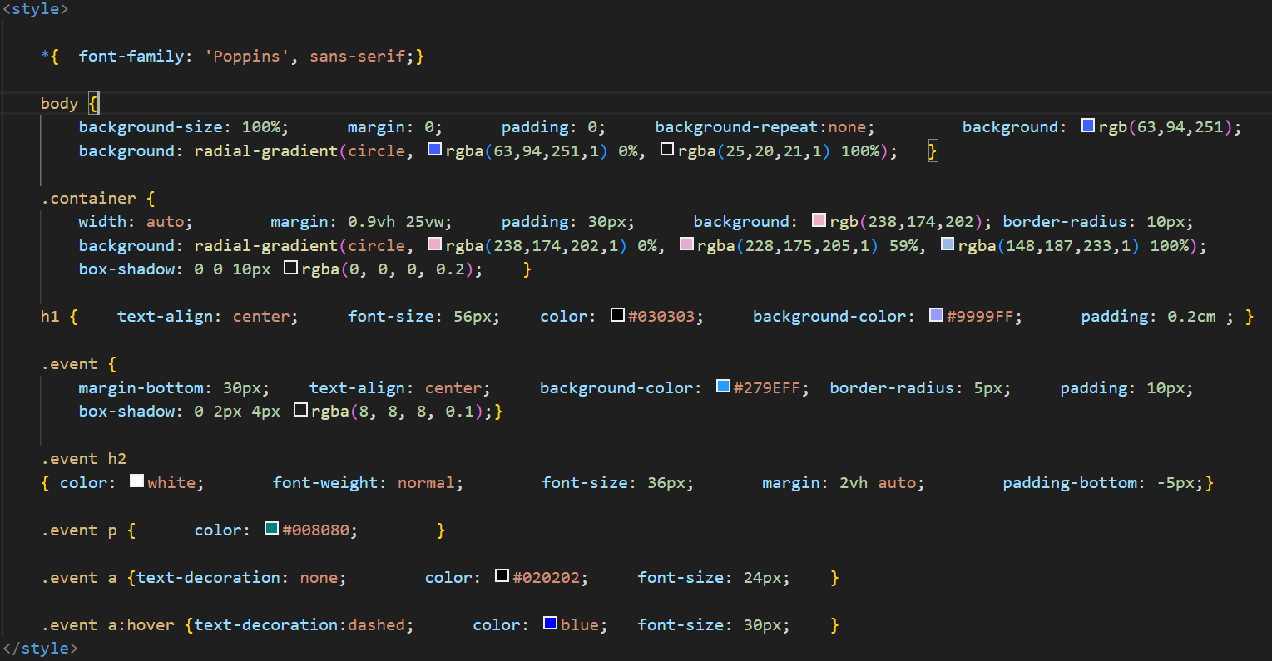
Project Highlights
Home Page CSS Codes

Slide 16
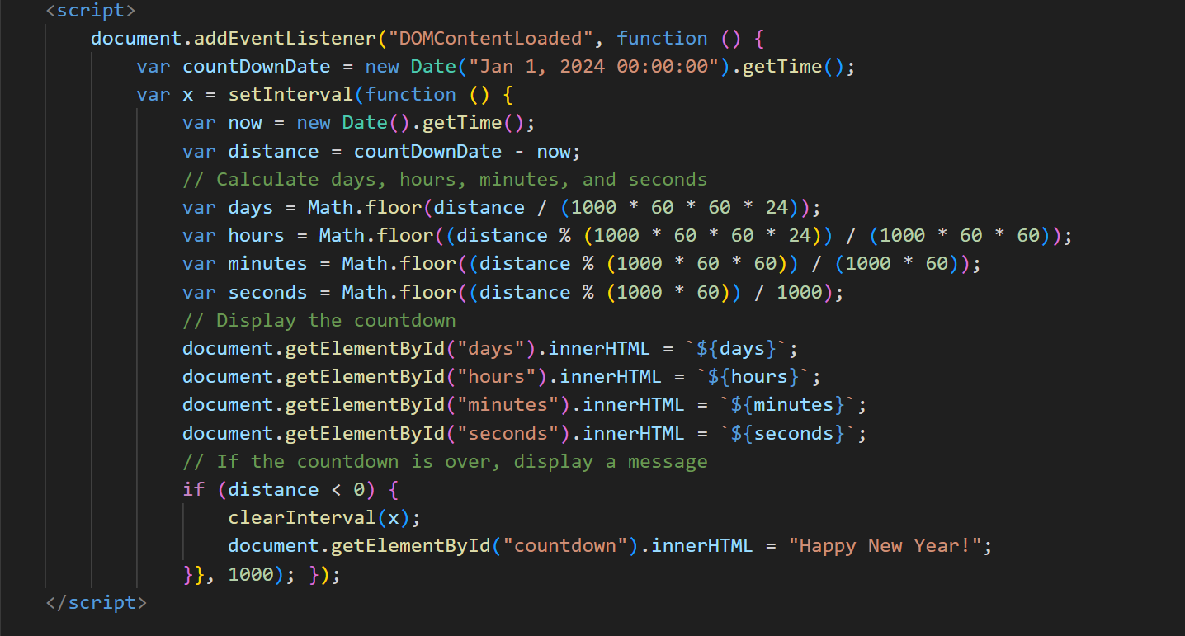
Project Highlights
New Year Countdown JavaScript

Slide 17
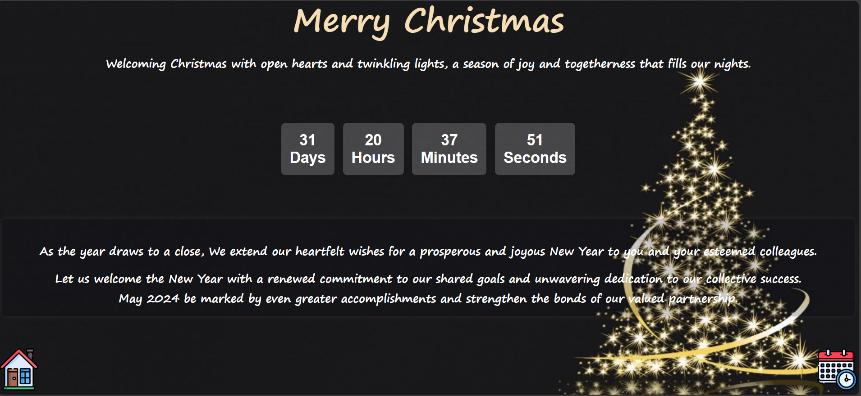
Project Highlights
Christmas Web Page

Slide 18
Project Highlights
Merry Christmas Html Tags Used
The main HTML tags used in structuring of New Year countdown web page are:
<html>: Defines the root of an HTML document.
<link>: Specifies external resources, such as stylesheets, linked to the document.
<body>: Represents the content of an HTML document, including text, images, links, etc.
<head>: Contains meta-information about the HTML document, such as title and links.
<header>: Represents introductory content at the beginning of a section or page.
<style>: Contains CSS (Cascading Style Sheets) to define the presentation of the document.
<title>: Defines the title of the HTML document, displayed in the browser's title bar or tab.
<div>: A container element used to group other HTML elements and apply styles or scripting.
<span>: An inline container used for applying styles or scripting to a specific portion of text.
<p>: Represents a paragraph of text.
<footer>: Represents the footer of a section or page, typically containing metadata, copyright information, etc.
<script>: Contains or links to scripting code, usually JavaScript, for enhancing interactivity or functionality.

Slide 19
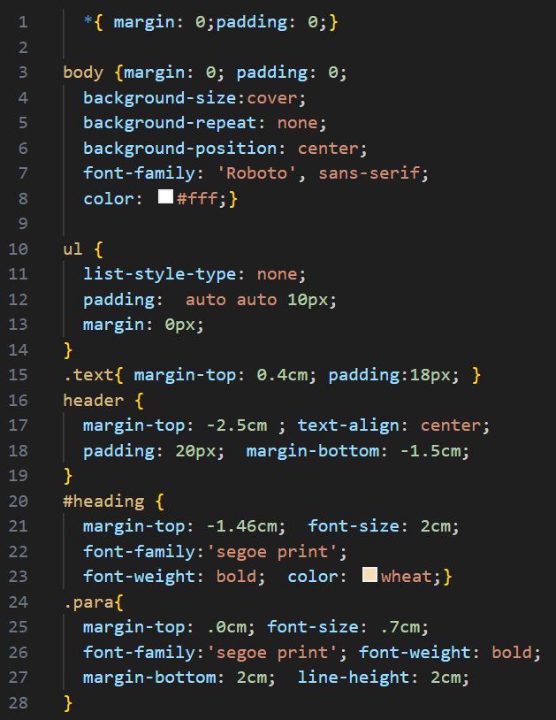
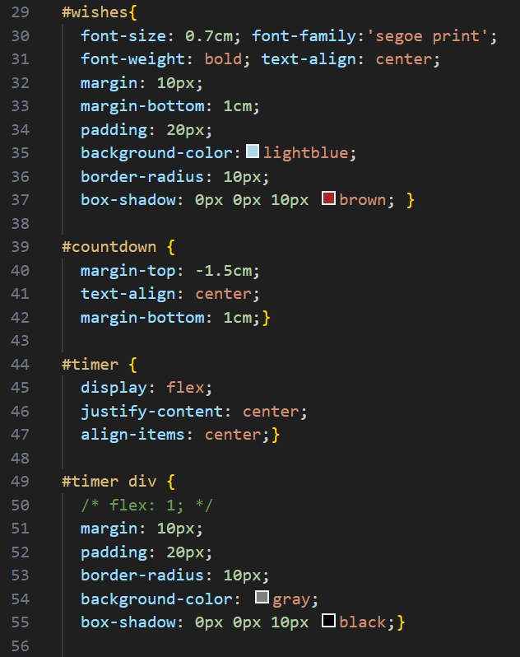
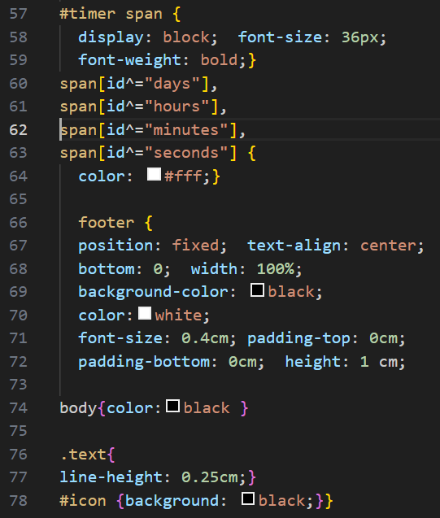
Project Highlights
New year and Christmas Web page CSS

Slide 20
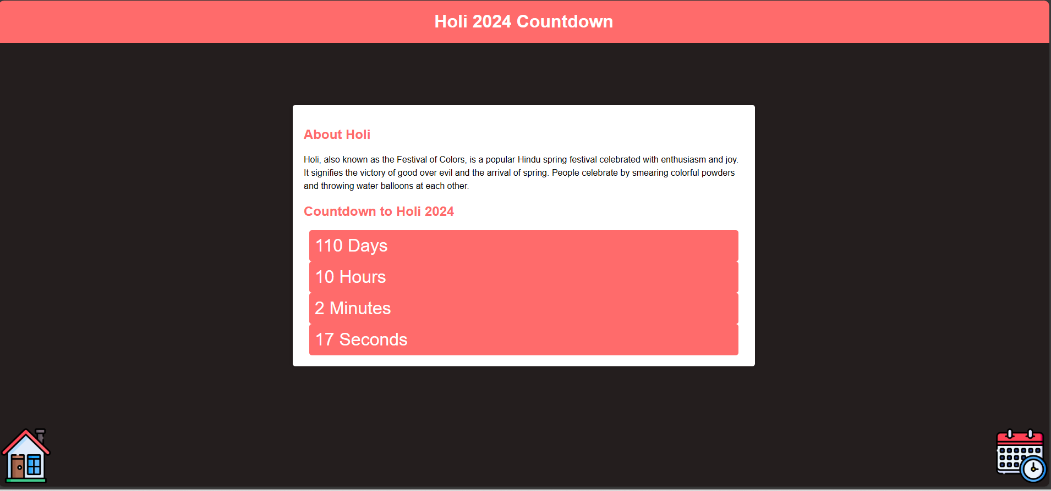
Project Highlights
Holi web Page

Slide 21
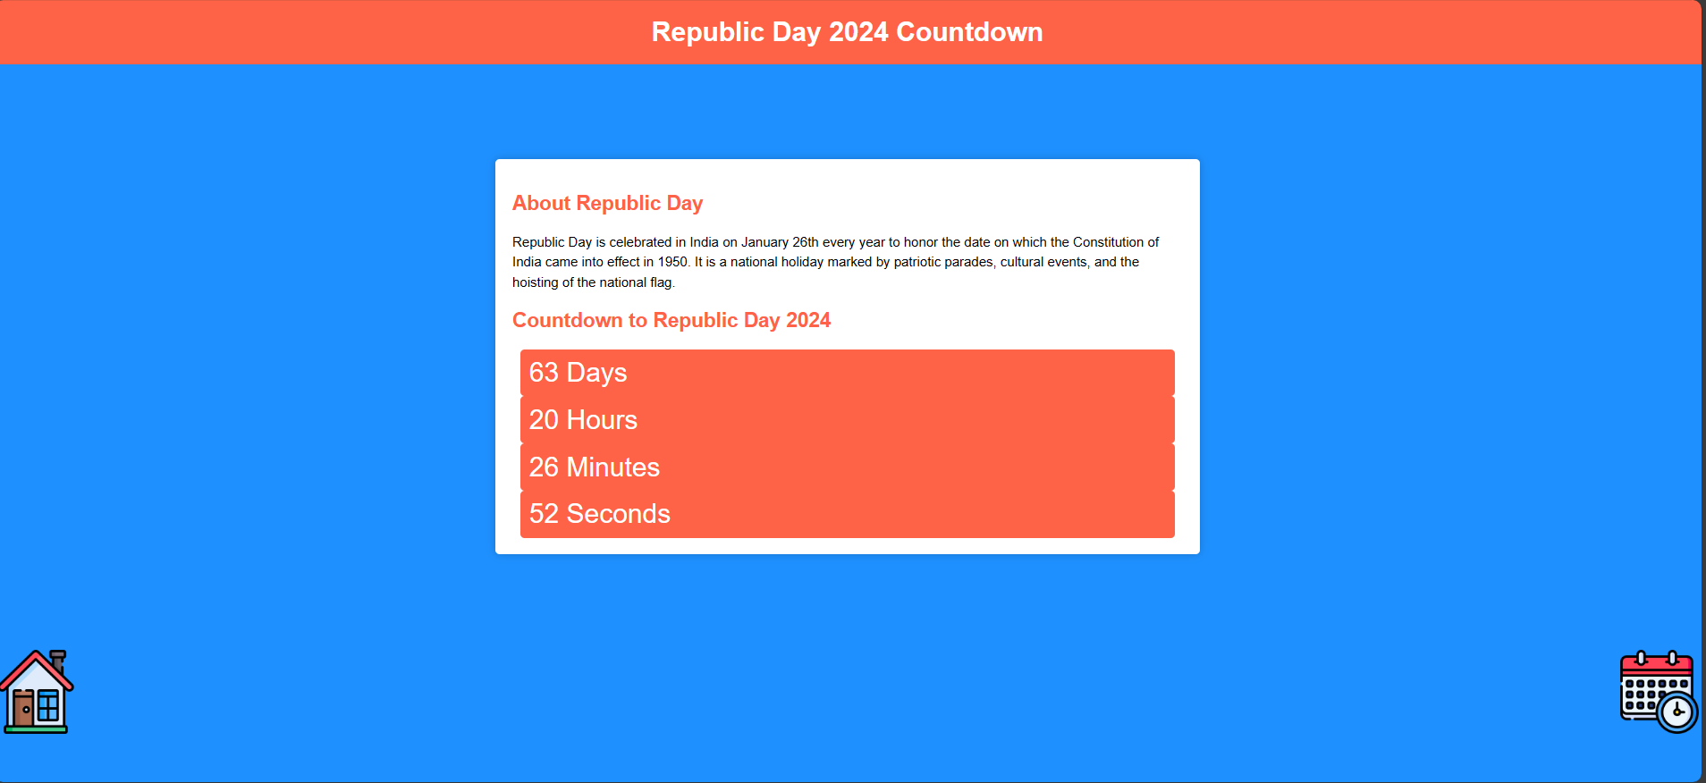
Project Highlights
Republic Day web Page

Slide 22
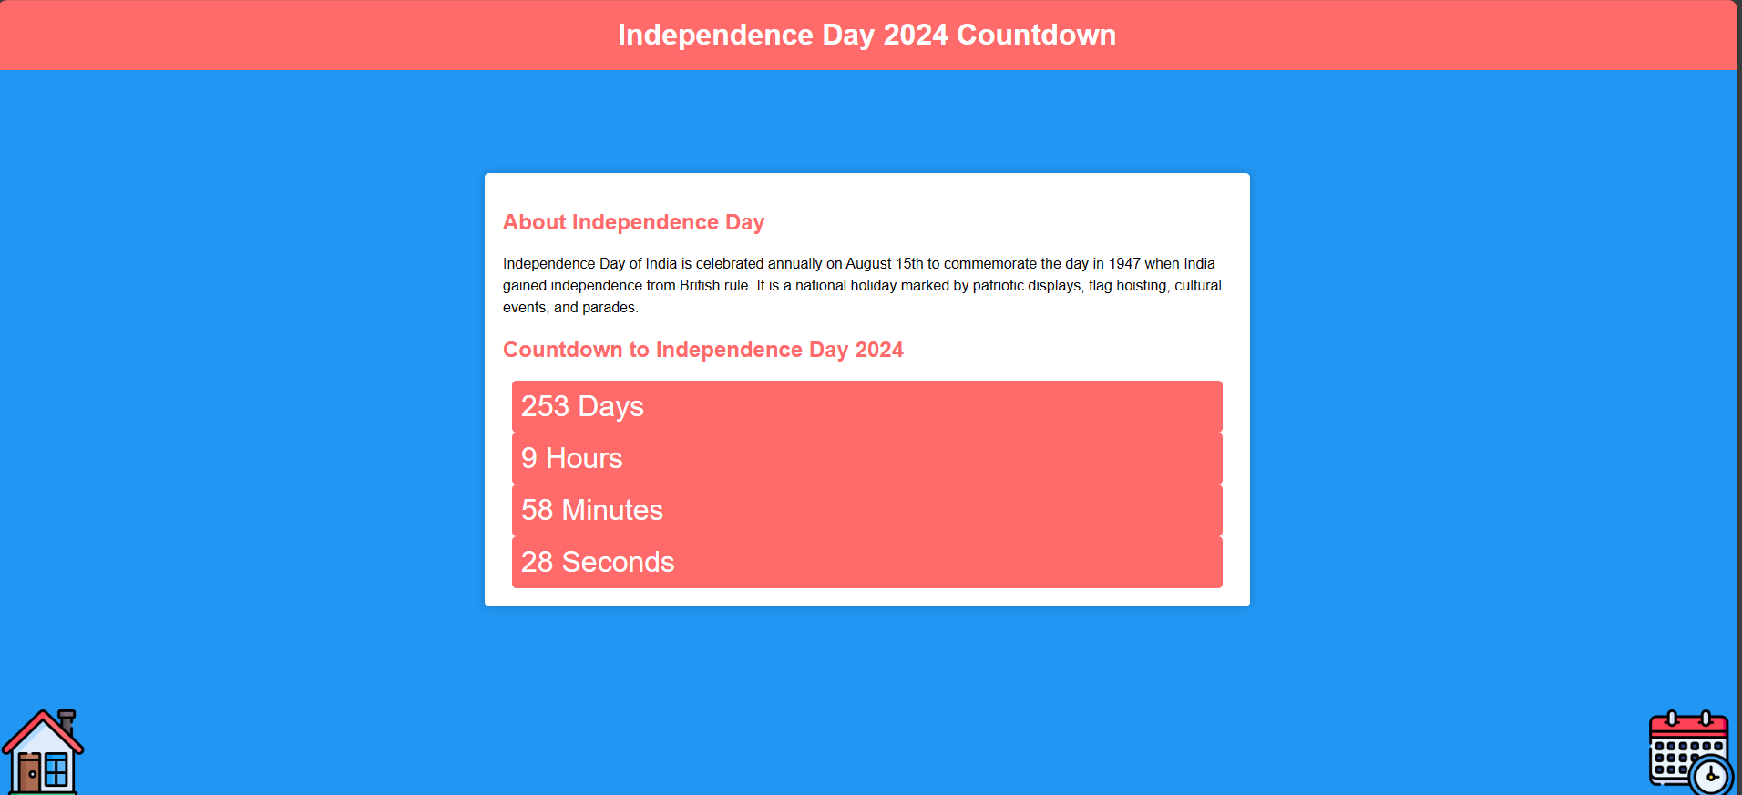
Project Highlights
Independence Day web Page

Slide 23
Project Highlights
Holi, Republic Day, Independence Day Html Tags Used
The main HTML tags used in structuring of Holi, Republic Day, Independence Day countdown web page are:
<html>: Defines the root of an HTML document.
<link>: Specifies external resources, such as stylesheets, linked to the document.
<body>: Represents the content of an HTML document, including text, images, links, etc.
<head>: Contains meta-information about the HTML document, such as title and links.
<header>: Represents introductory content at the beginning of a section or page.
<style>: Contains CSS (Cascading Style Sheets) to define the presentation of the document.
<title>: Defines the title of the HTML document, displayed in the browser's title bar or tab.
<div>: A container element used to group other HTML elements and apply styles or scripting.
<span>: An inline container used for applying styles or scripting to a specific portion of text.
<p>: Represents a paragraph of text.
<footer>: Represents the footer of a section or page, typically containing metadata, copyright information, etc.
<script>: Contains or links to scripting code, usually JavaScript, for enhancing interactivity or functionality.

Slide 24
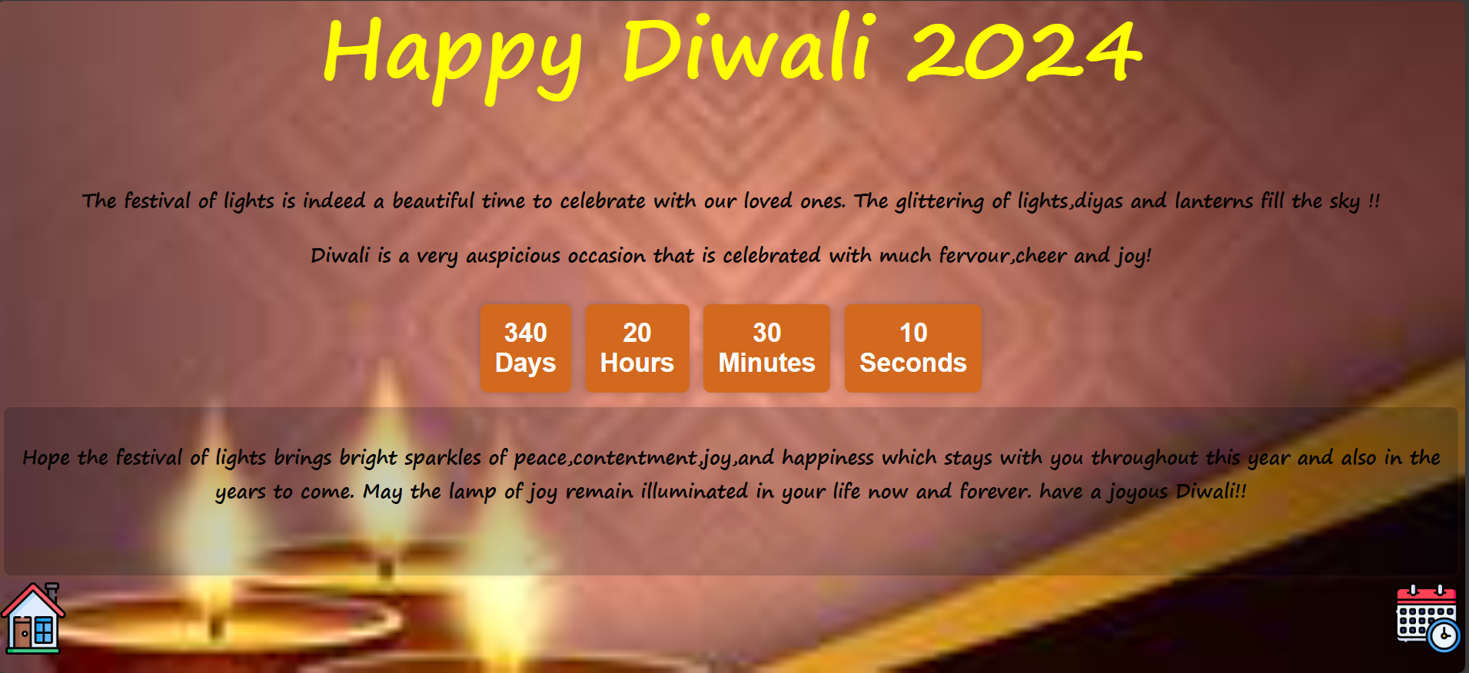
Project Highlights
Diwali web Page

Slide 25
Project Highlights
Diwali Web Page HTML Tags
The main HTML tags used in structuring of Diwali countdown web page are:
<html>: Defines the root of an HTML document.
<link>: Specifies external resources, such as stylesheets, linked to the document.
<body>: Represents the content of an HTML document, including text, images, links, etc.
<head>: Contains meta-information about the HTML document, such as title and links.
<header>: Represents introductory content at the beginning of a section or page.
<style>: Contains CSS (Cascading Style Sheets) to define the presentation of the document.
<title>: Defines the title of the HTML document, displayed in the browser's title bar or tab.
<div>: A container element used to group other HTML elements and apply styles or scripting.
<span>: An inline container used for applying styles or scripting to a specific portion of text.
<p>: Represents a paragraph of text.
<footer>: Represents the footer of a section or page, typically containing metadata, copyright information, etc.
<script>: Contains or links to scripting code, usually JavaScript, for enhancing interactivity or functionality.

Slide 26
Project Highlights
Diwali Web page CSS

Slide 27
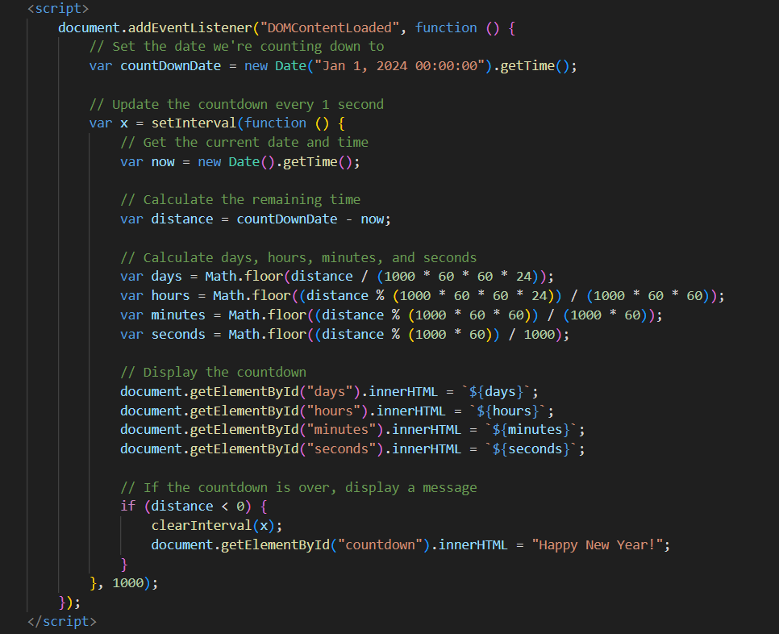
Project Highlights
JavaScript Logic for all Web Pages

Slide 28
Conclusion
Project Insights:
The Project helped us to learn the practical use of HTML, CSS and JavaScript.
The project also helped us to learn how to work like a team.
During the research for the project, we came across a various platforms for images, CSS, icons and many more which contributed in overall development of our skills.
The Countdown page for a specific event helped us to effectively calculate time left for that particular event.

Slide 29
References/Links used
The following references were used in the completion of the project:
Information:
Platforms:
Brittanica
Links:
New year- https://www.britannica.com/topic/New-Year-festival
Christmas- https://www.britannica.com/topic/Christmas
Diwali- https://www.britannica.com/topic/Diwali-Hindu-festival
Holi- https://www.britannica.com/topic/Holi
Independence Day- https://www.britannica.com/topic/Independence-Day-Indian-holiday
Republic Day- https://www.britannica.com/topic/Republic-Day-India
Background images:
Platforms:
Postimage
Vecteezy

Slide 30
References/Links used
Links:
New year webpage background image- https://postimg.cc/mPZG9Ccc
Diwali Webpage background image-https://static.vecteezy.com/system/resources/thumbnails/000/251/537/small/abstract-happy-diwali-decorative-background.jpg
Icons:
Platforms:
Flaticon
Links:
Calendar icon - https://cdn-icons-png.flaticon.com/512/3652/3652267.png
Home page icon- https://cdn-icons-png.flaticon.com/512/2544/2544087.png
CSS Style Sheets:
fonts.googleapis.com/css2?family=Poppins&display=swap
https://fonts.gstatic.com

Slide 31


